Slide 1


MARKETING STRATEGY SERIES
Co n n e c t i n g w i t h E d u c a t o r s t h r o u g h S o c i a l + D i g i t a l M a r k e t i n g
Kassidy Krown, Digital Mktg Dir Agile Education Marketing

Slide 2

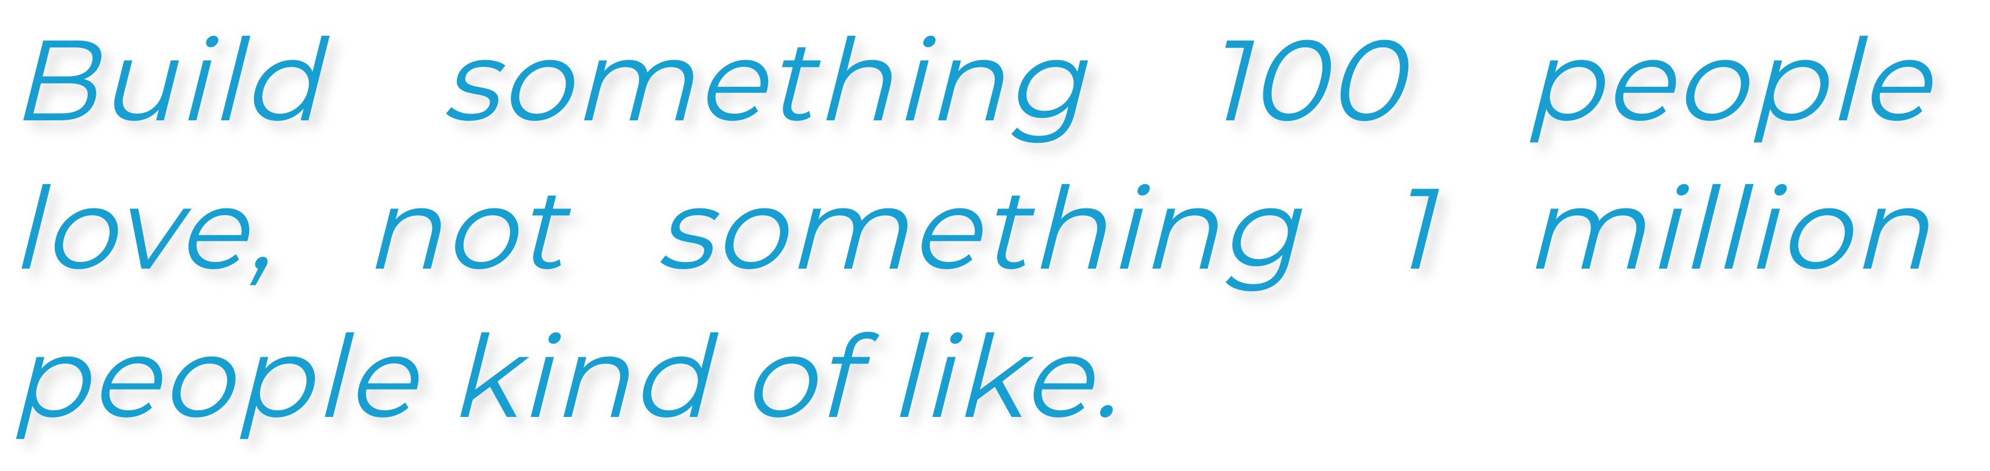
- BRIAN CHESKY, AIRBNB CO-FOUNDER

Slide 3




AGENDA
1
The Importance of Social + Digital Advertising
Agenda 1
2
Understanding Which Platforms Are Right for Your Business Strategy
Agenda 2
Agenda 3
3
Social + Digital Marketing Best Practices

Slide 4
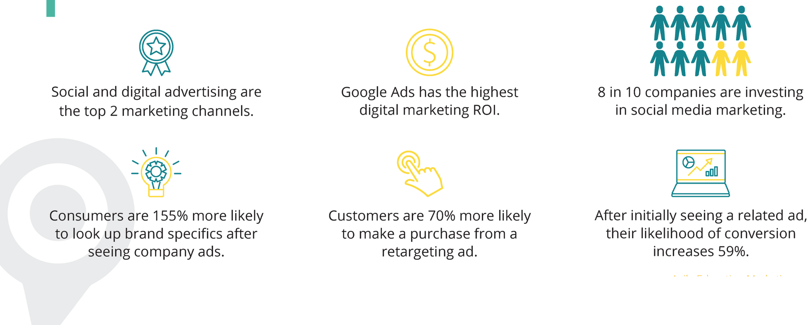
THE IMPORTANCE
OF SOCIAL + DIGITAL MARKETING

Slide 5

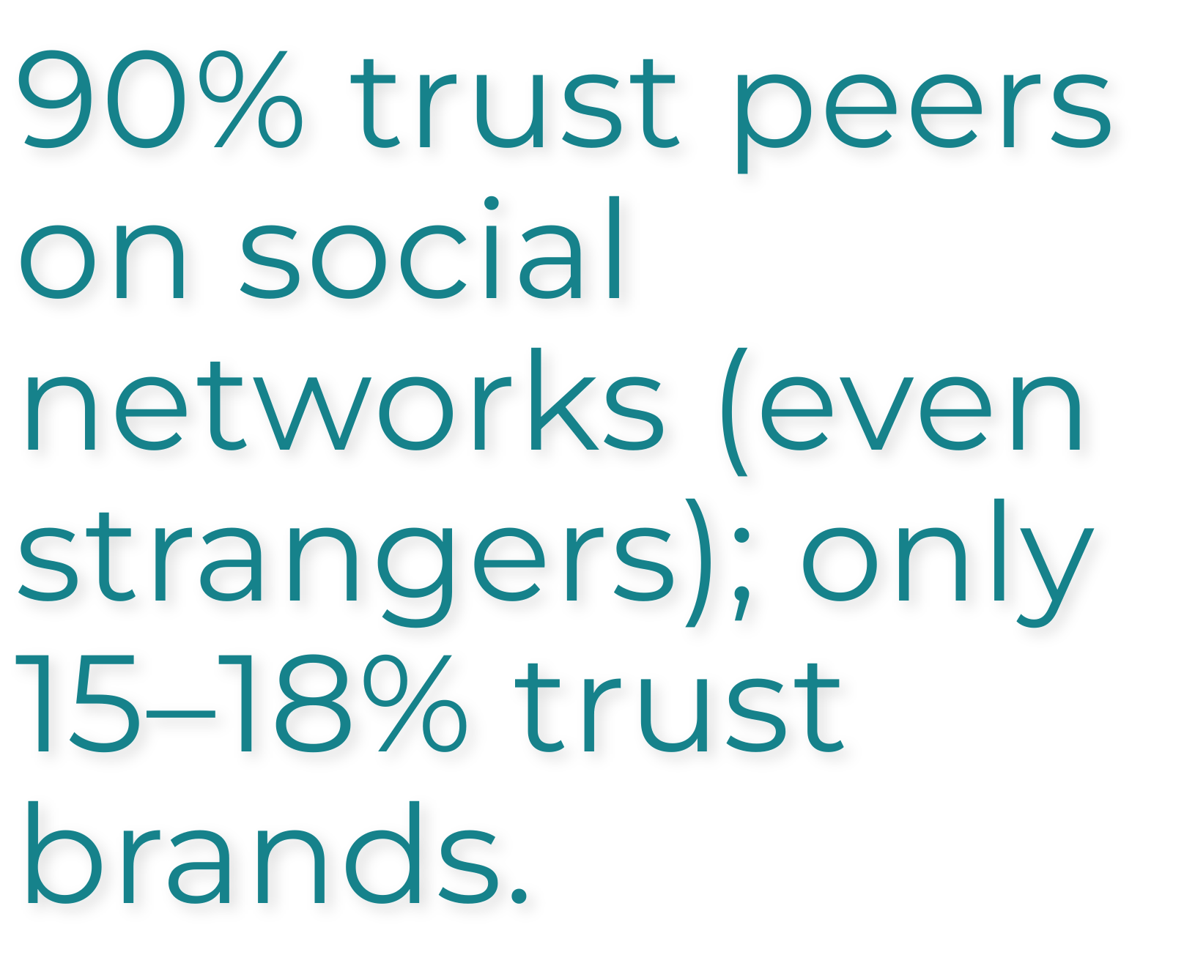

DANNY BROWN, AWARD-WINNING
AUTHOR + MARKETER

Slide 6
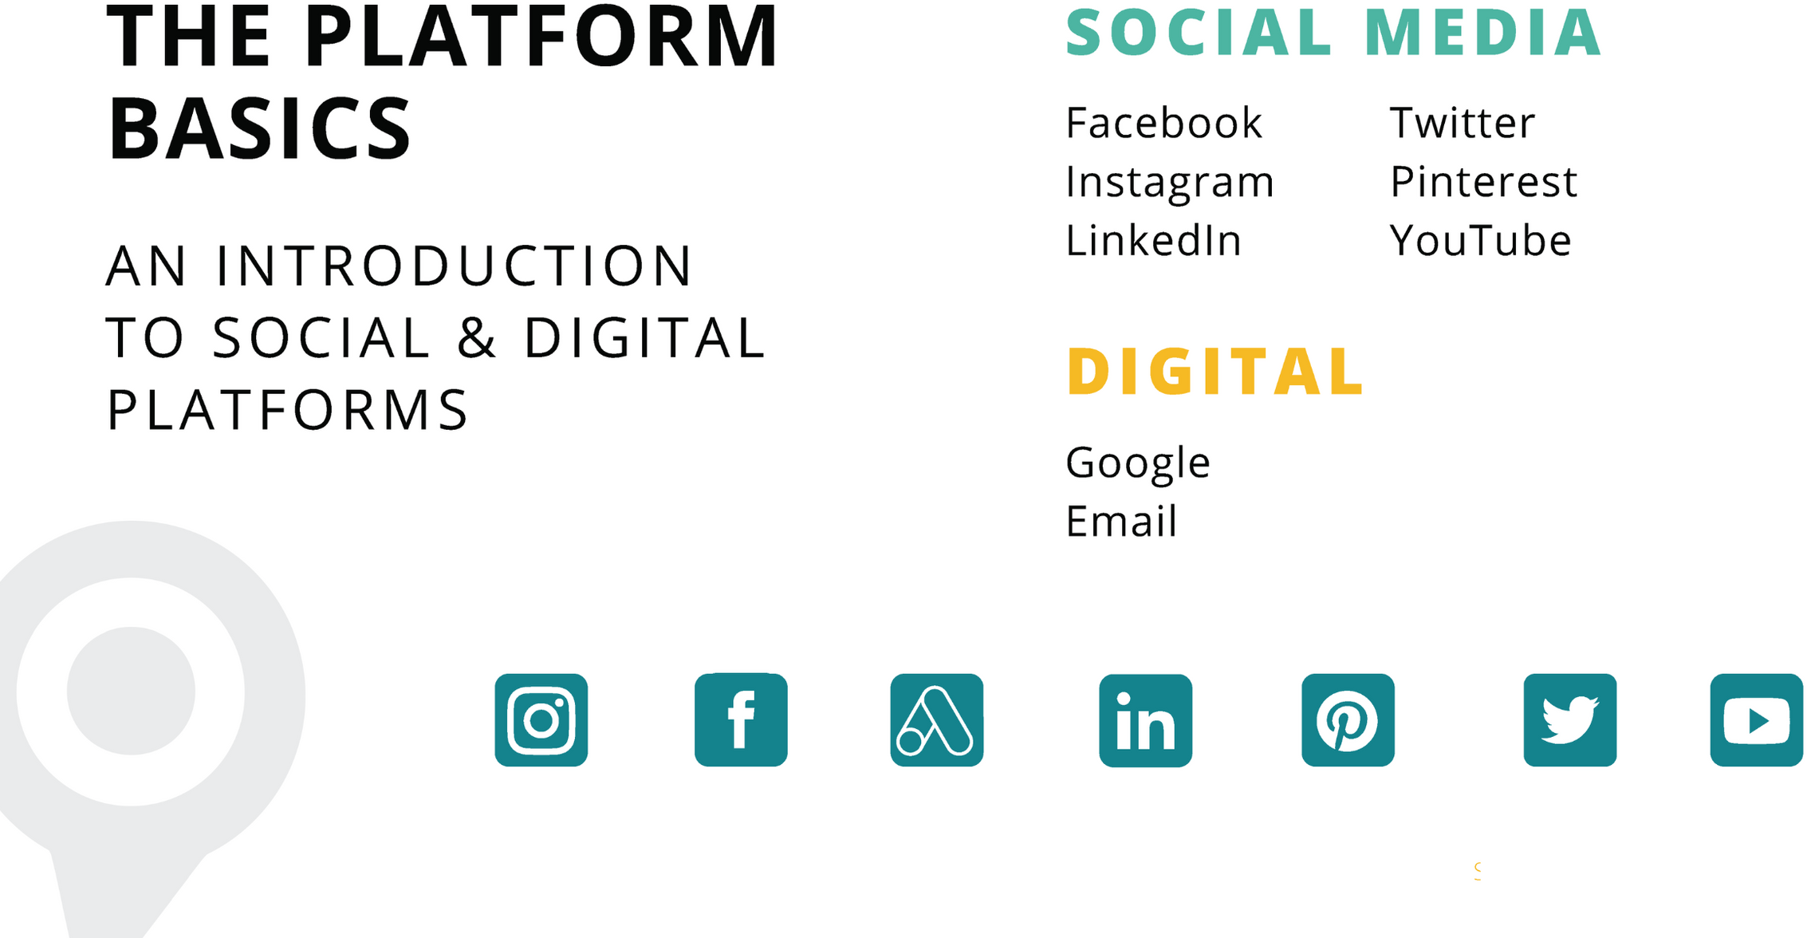


Slide 7


T E A C H E R S A S F R O N T L I N E W O R K E R S

Slide 8
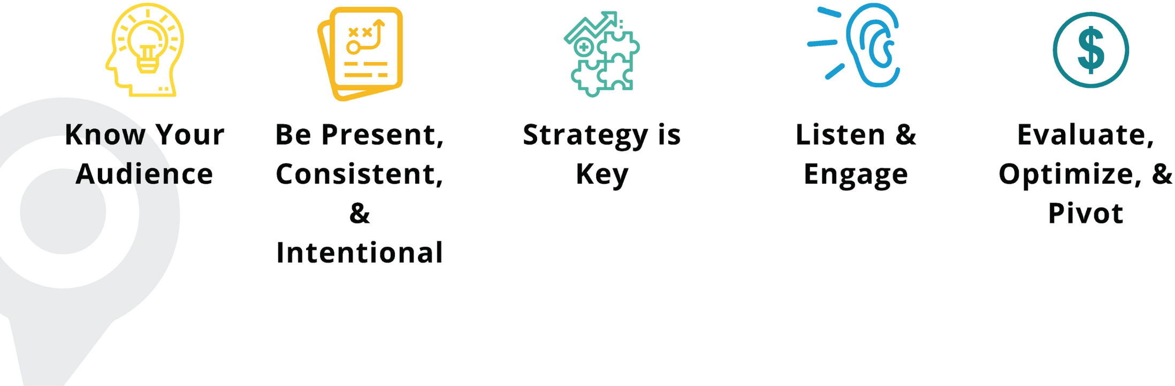
BEST PRACTICES
FOR SOCIAL + DIGITAL ADVERTISING

Slide 9
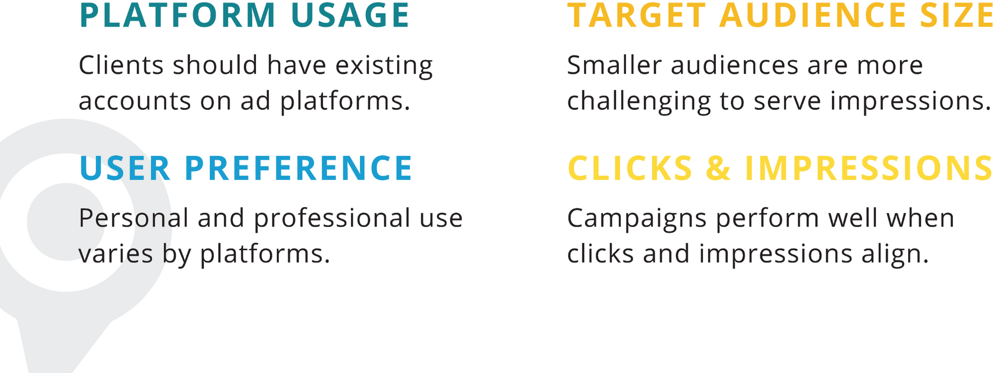
KEY POINTS TO REMEMBER
FOR SOCIAL + DIGITAL ADVERTISING

